Slide 1

Convolutional Neural Network
Risman Adnan
Telkom University

Slide 2
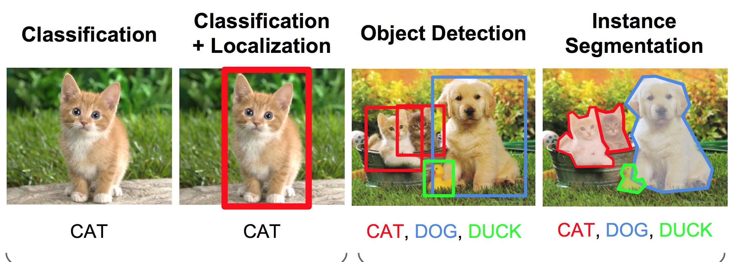
Computer Vision Tasks

Slide 3
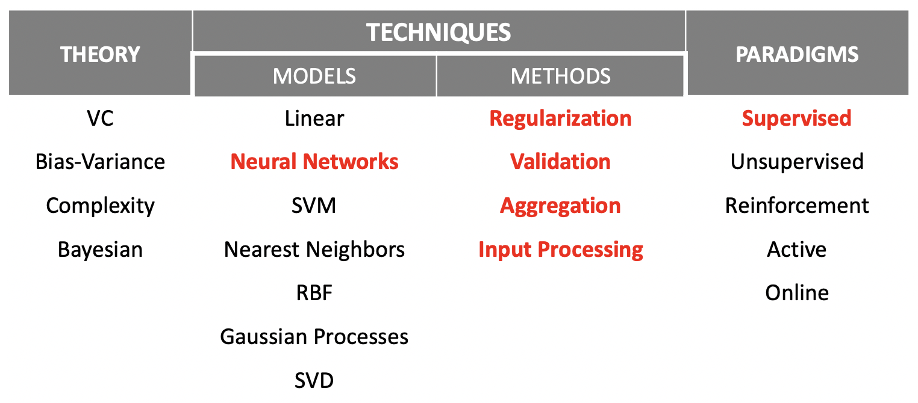
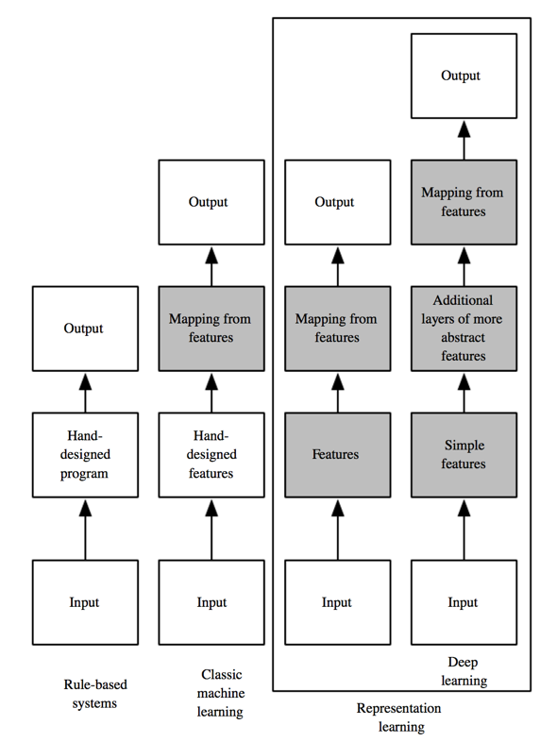
Machine Learning vs Deep Learning
Notes:
References:
Yoshua Bengio – Deep Learning
Yasser Abu-Mustofa – Learning from Data
Hierarchy of concepts, learn complicated concepts from simpler ones → if we draw a graph, it should be deep.

Slide 4
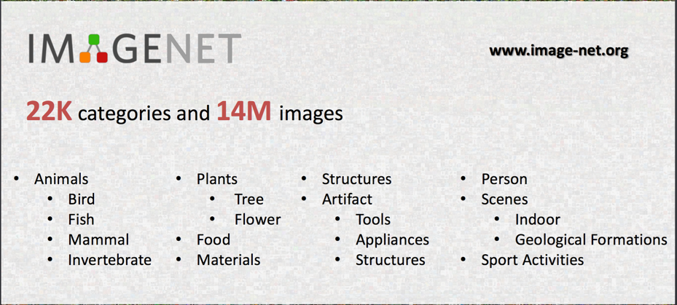
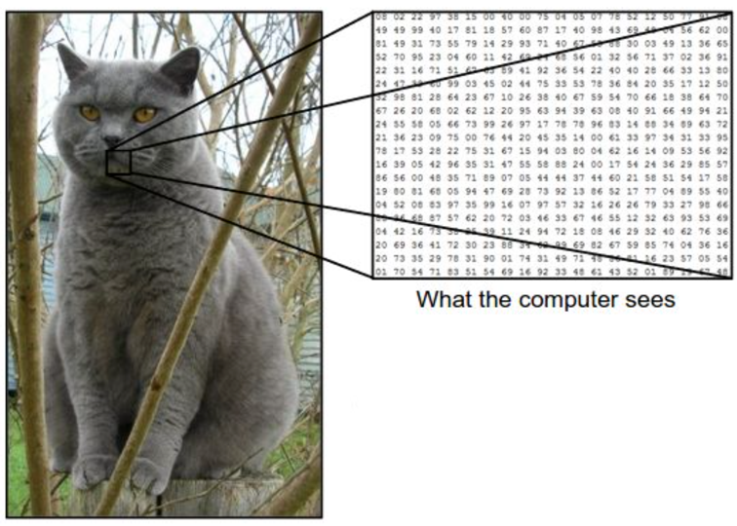
Image Classification Problem
Core task in computer vision: can we recognize object?
Image represented as 3D array or simply vector.
Supervised learning with labeled dataset.
Datasets: ImageNet, CIFAR-10, etc.

Slide 5
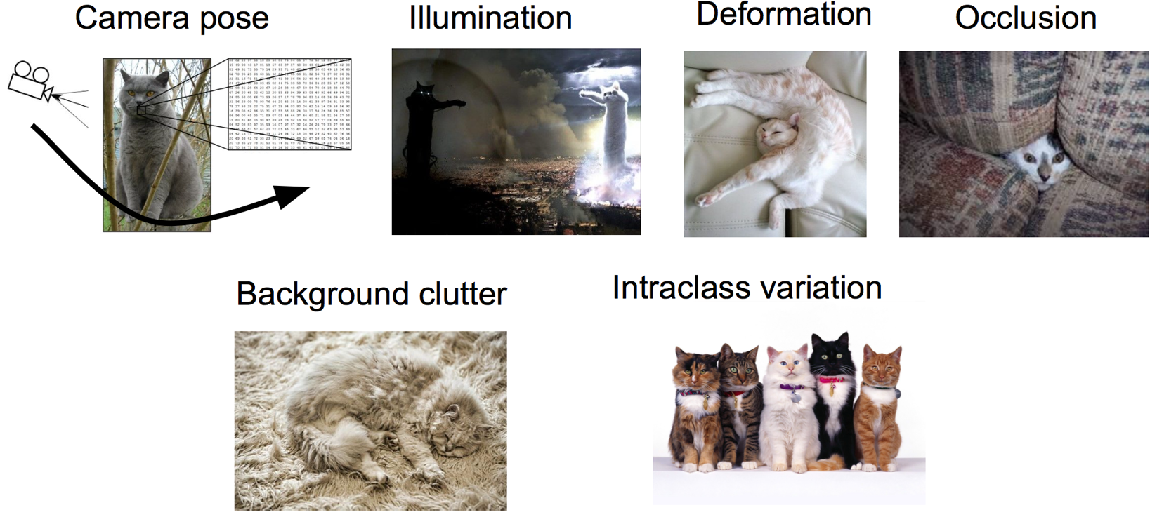
Key Challenges

Slide 6
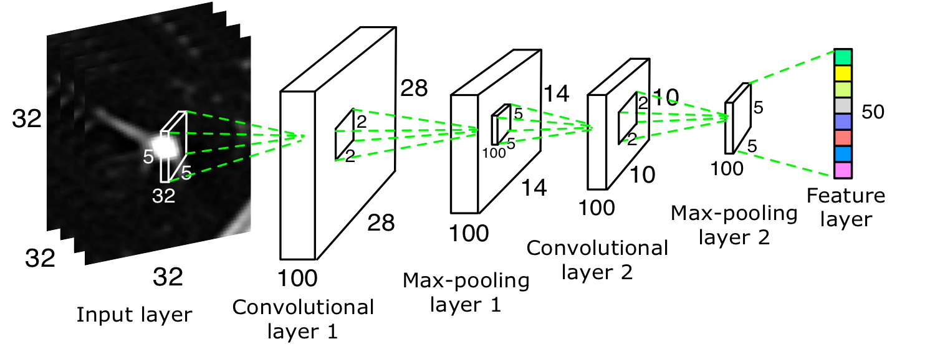
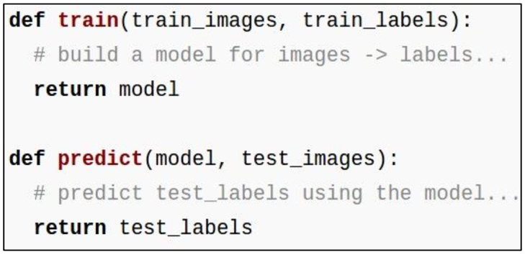
Convolutional Neural Network
Supervised Learning Approach
Collect a dataset of images and labels
Use CNN model to train an image classifier
CNN has automatic feature extraction
Evaluate the classifier on a withheld set of test images

Slide 7
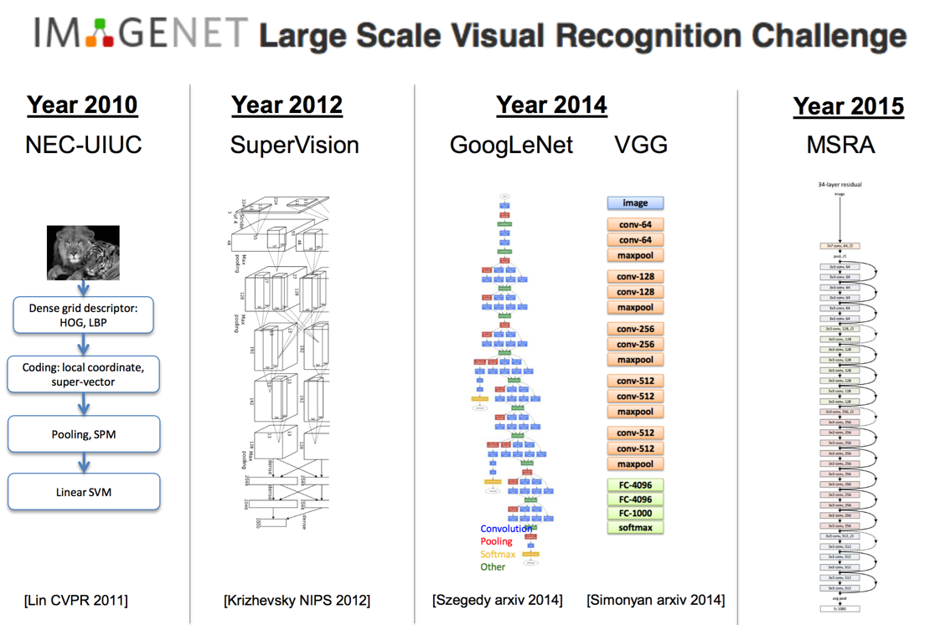
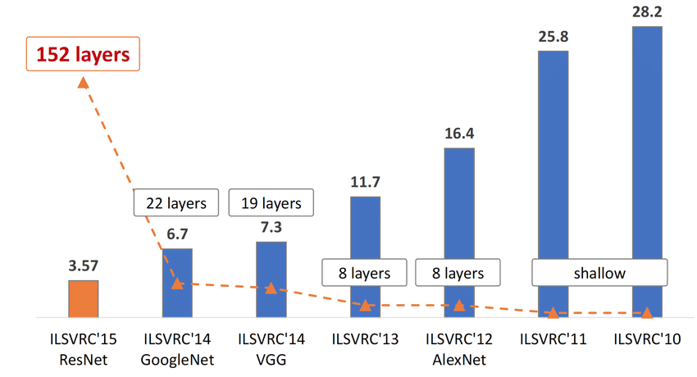
Image Classification State-of-Arts

Slide 8
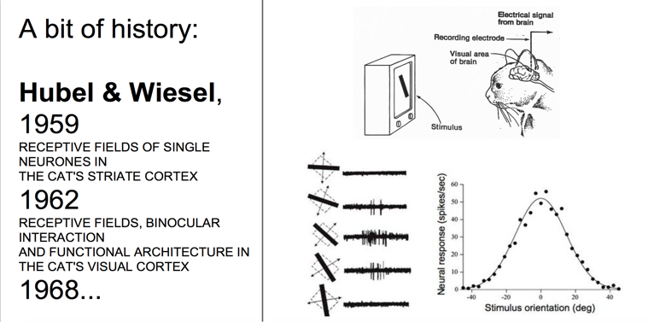
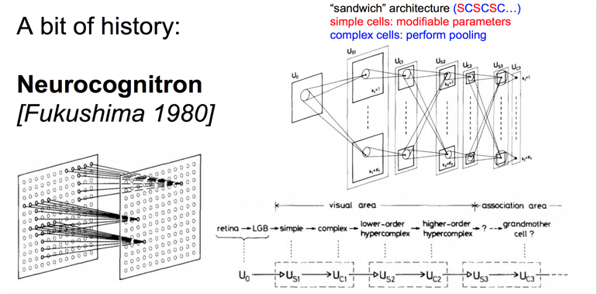
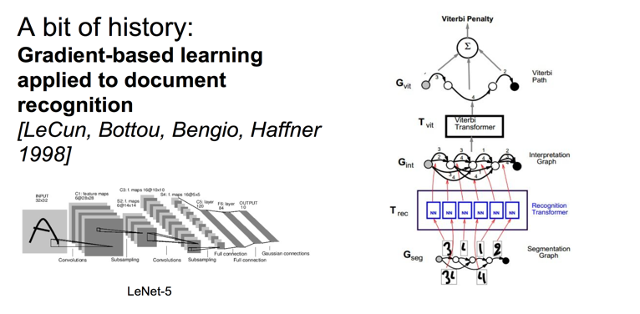
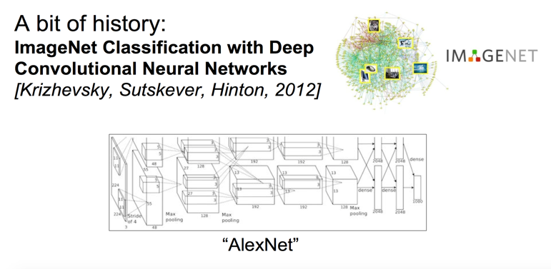
History of Convolutional Neural Network

Slide 9
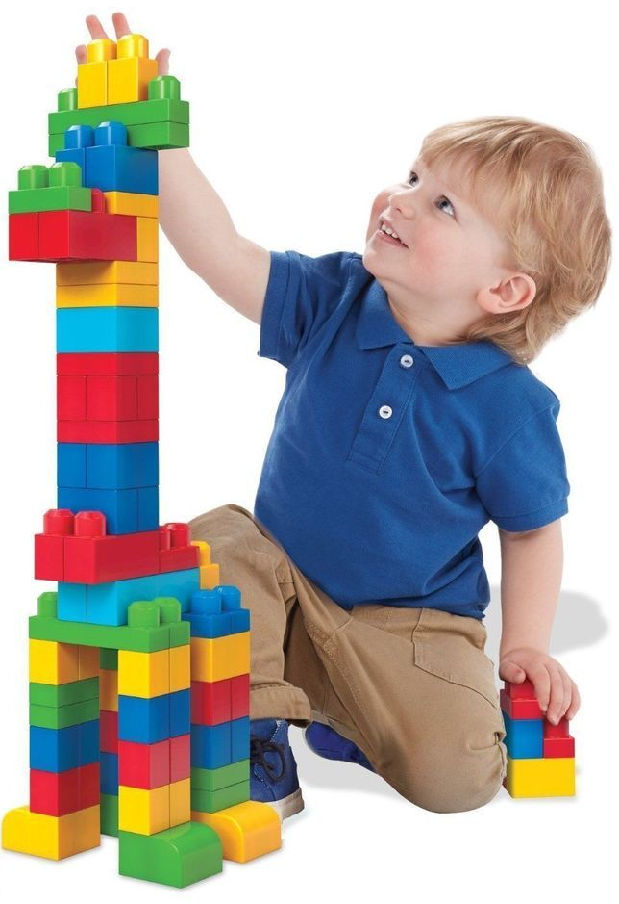
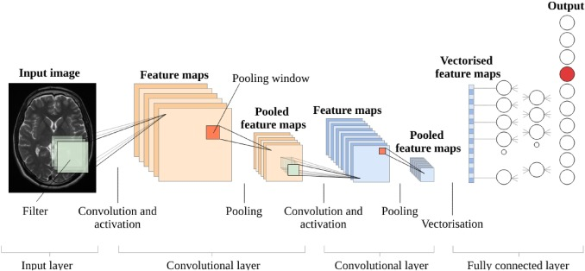
Convolutional Neural Network (ConvNets)

Slide 10
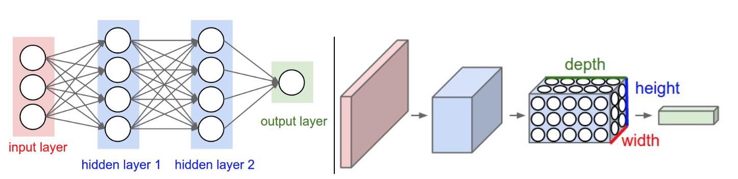
ConvNets Architecture

Slide 11
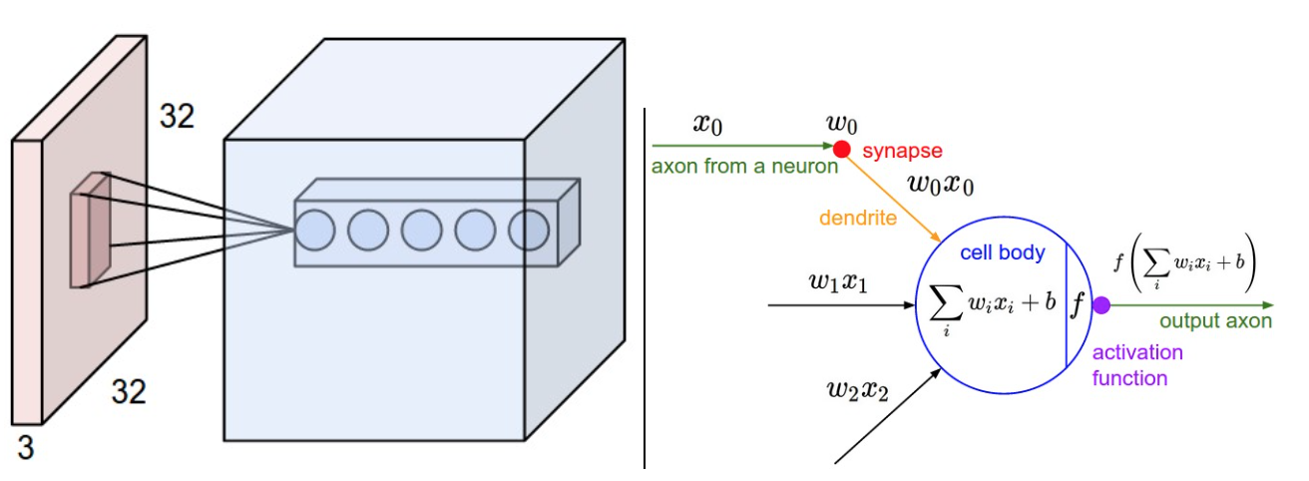
ConvNets Architecture

Slide 12
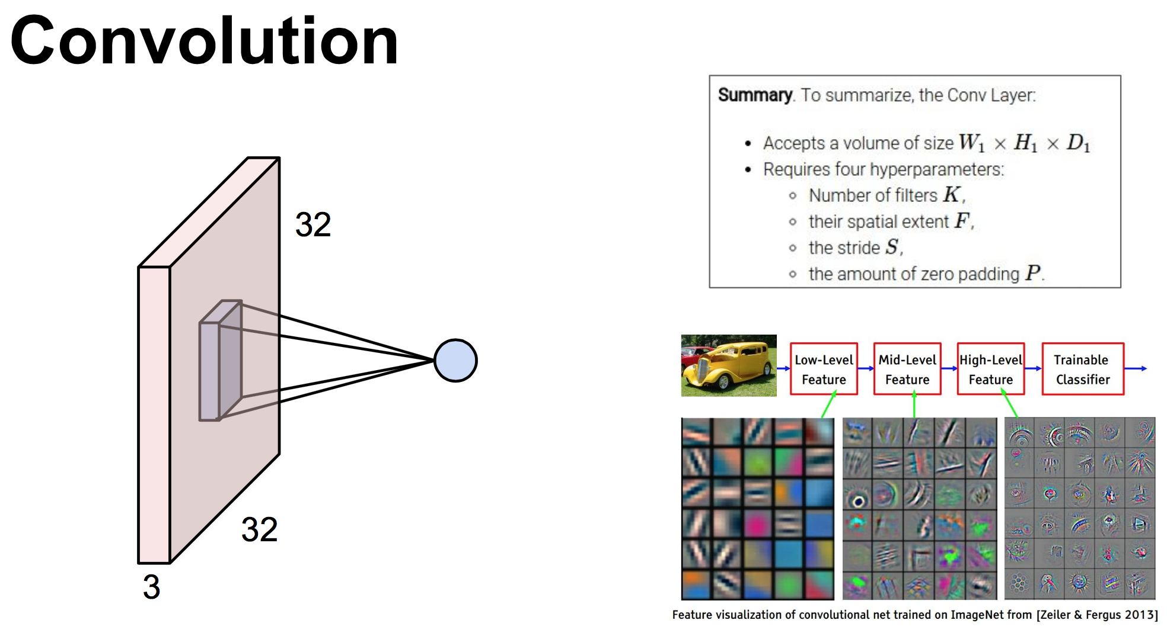

Slide 13
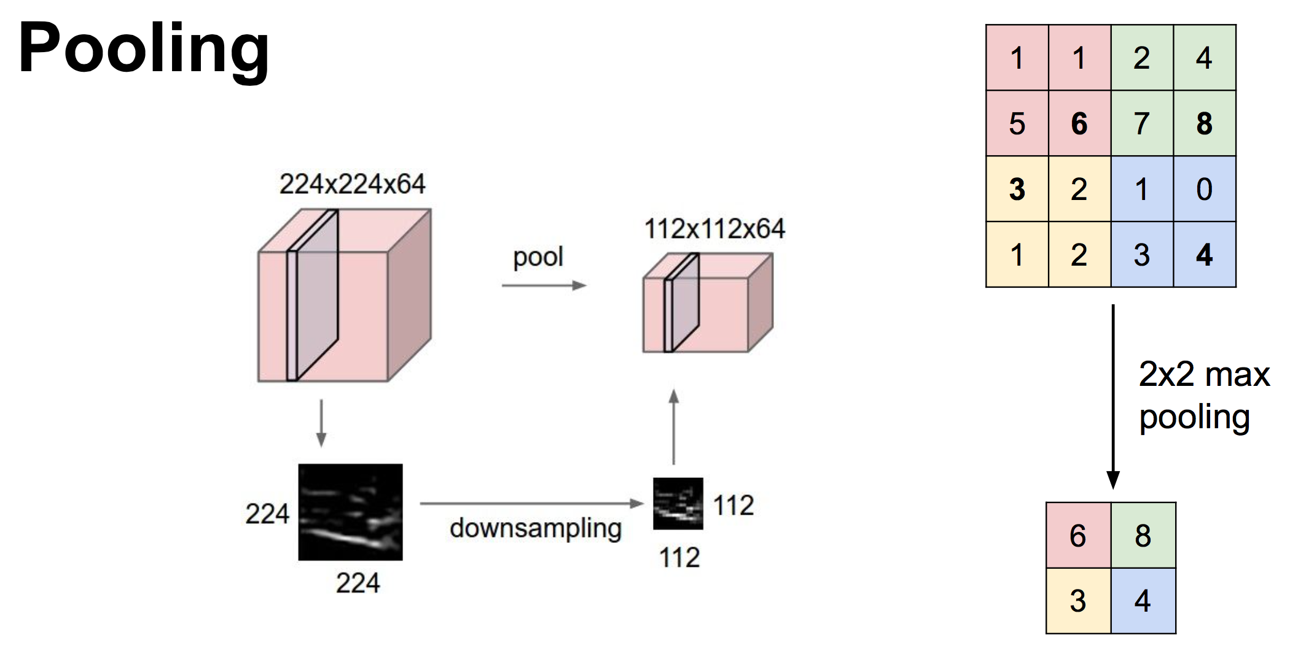

Slide 14
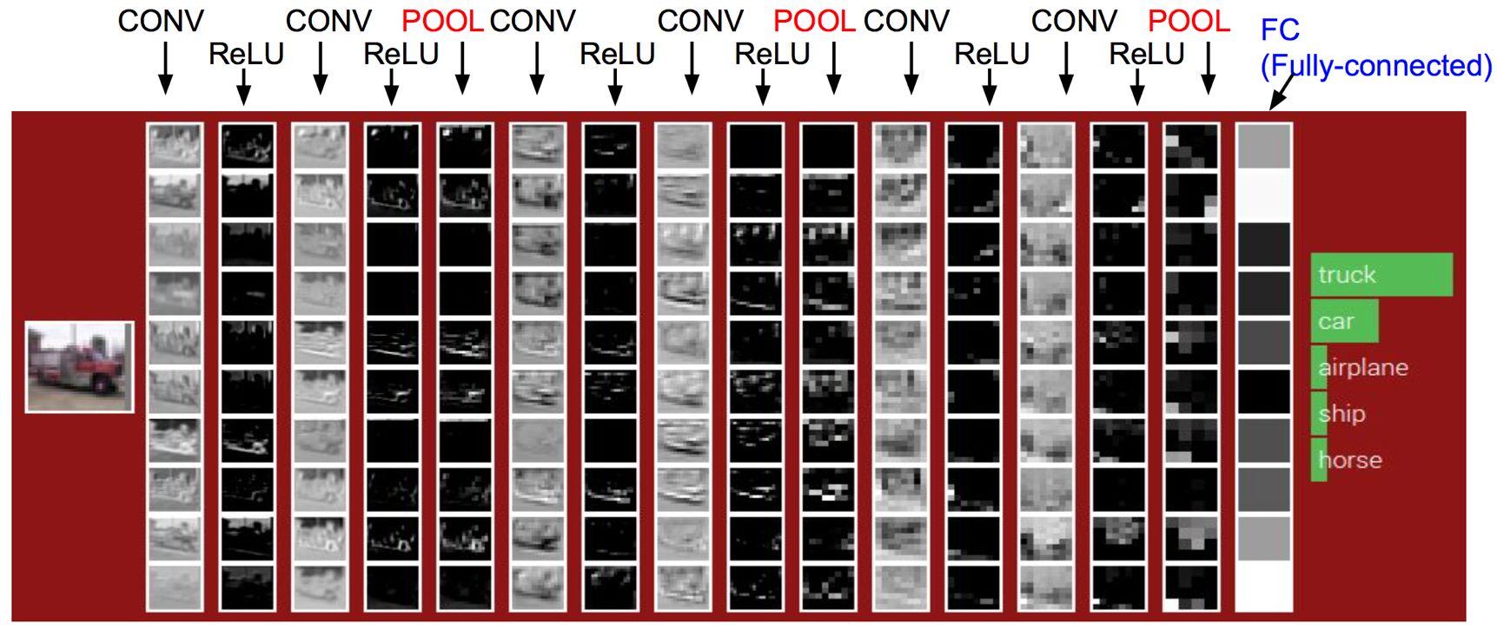
ConvNets Architecture

Slide 15
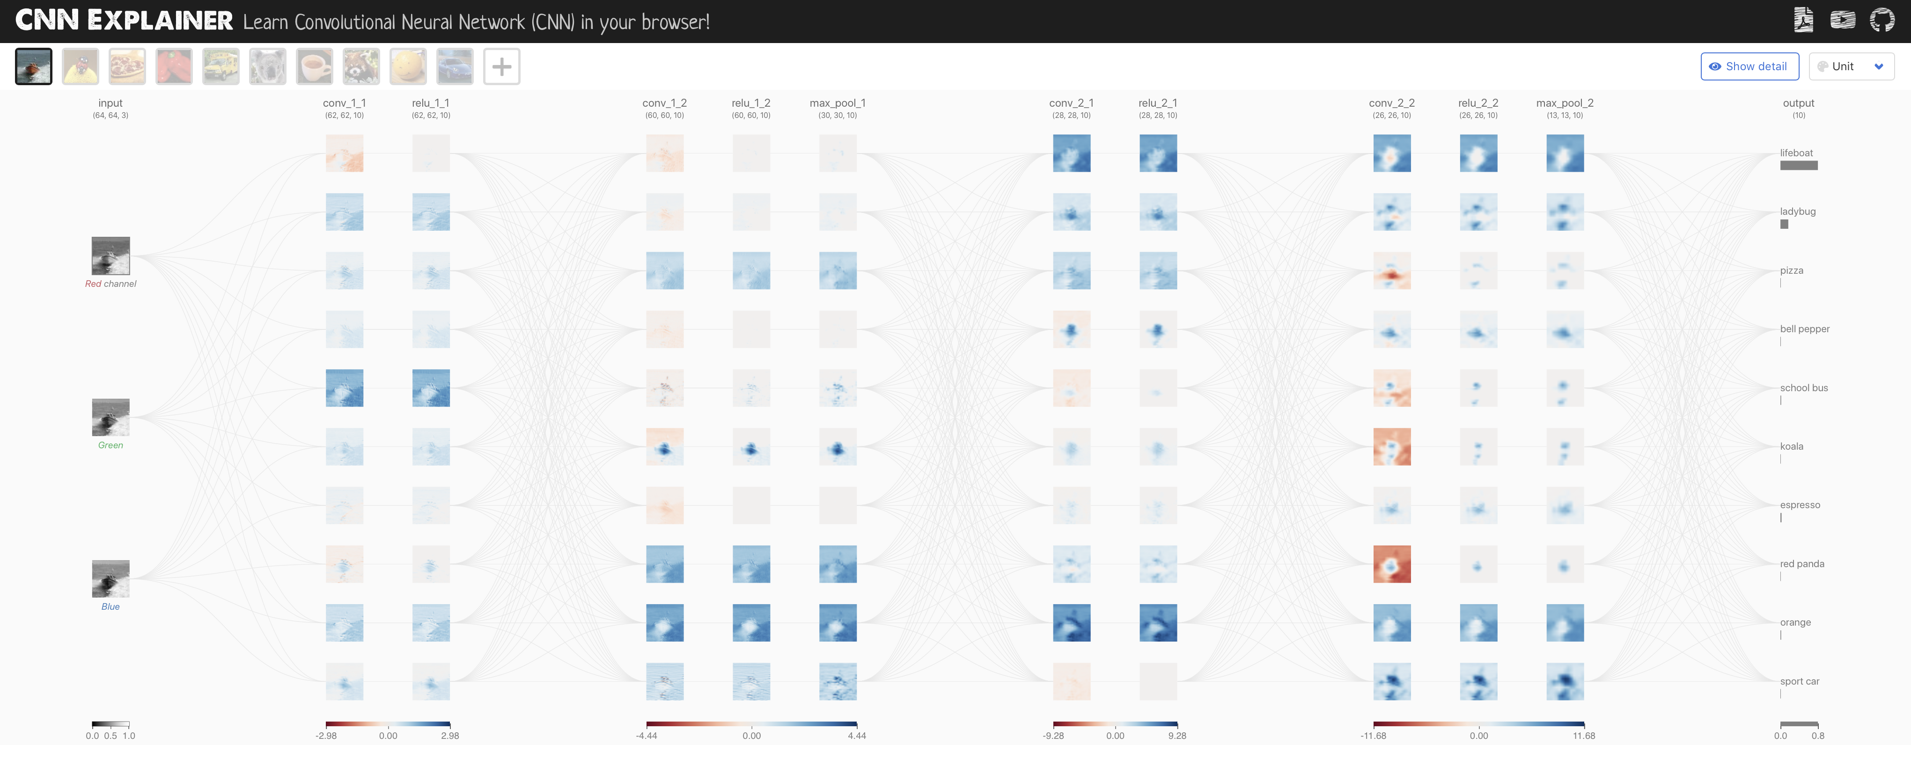
How ConvNets Works

Slide 16
APPENDIX How ConvNets Work
Telkom University

Slide 17
A Toy ConvNet: X’s and O’s
Says whether a picture is of an X or an O
A two-dimensional
array of pixels
CNN
X or O

Slide 18
For Example
CNN
X
CNN
O

Slide 19
Trickier Cases
CNN
X
translation
scaling
rotation
weight
CNN
O

Slide 20
Deciding is Hard
?
=

Slide 21
What Computers See
?
=

Slide 22
What Computers See

Slide 23
Computers are Literal
=
x

Slide 24
ConvNets Match Pieces of the Image
=
=
=

Slide 25
Features Match Pieces of the Image

Slide 31
Filtering: The Math Behind the Match

Slide 32


Slide 33
Filtering: The Math Behind the Match
Line up the feature and the image patch.
Multiply each image pixel by the corresponding feature pixel.
Add them up.
Divide by the total number of pixels in the feature.

Slide 34
Filtering: The Math Behind the Match
1 x 1 = 1

Slide 35
Filtering: The Math Behind the Match
1 x 1 = 1

Slide 36
Filtering: The Math Behind the Match
-1 x -1 = 1

Slide 37
Filtering: The Math Behind the Match
-1 x -1 = 1

Slide 38
Filtering: The Math Behind the Match
-1 x -1 = 1

Slide 39
Filtering: The Math Behind the Match
1 x 1 = 1

Slide 40
Filtering: The Math Behind the Match
-1 x -1 = 1

Slide 41
Filtering: The Math Behind the Match
-1 x -1 = 1

Slide 42
Filtering: The Math Behind the Match
-1 x -1 = 1

Slide 43
Filtering: The Math Behind the Match
1 x 1 = 1

Slide 44
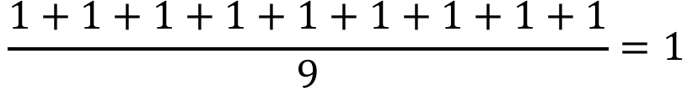
Filtering: The Math Behind the Match
$$\frac{1+1+1+1+1+1+1+1+1}{9}=1$$

Slide 45
Filtering: The Math Behind the Match
1 x 1 = 1

Slide 46
Filtering: The Math Behind the Match
-1 x 1 = -1

Slide 47
Filtering: The Math Behind the Match

Slide 48
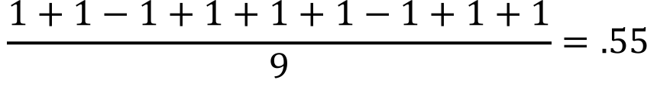
Filtering: The Math Behind the Match
$$\frac{1+1−1+1+1+1−1+1+1}{9}=.55$$
.55

Slide 49
Convolution: Trying Every Possible Match

Slide 50
Convolution: Trying Every Possible Match
=

Slide 51
=
=
=

Slide 52
Convolution Layer
One image becomes a stack of filtered images

Slide 53
Convolution Layer
One image becomes a stack of filtered images

Slide 54
Pooling: Shrinking the Image Stack
Pick a window size (usually 2 or 3).
Pick a stride (usually 2).
Walk your window across your filtered images.
From each window, take the maximum value.

Slide 55
Pooling
maximum

Slide 56
Pooling
maximum

Slide 57
Pooling
maximum

Slide 58
Pooling
maximum

Slide 59
Pooling
maximum

Slide 60
Pooling
max pooling

Slide 62
Pooling Layer
A stack of images becomes a stack of smaller images.

Slide 63
Normalization
Keep the math from breaking by tweaking each of the values just a bit.
Change everything negative to zero.

Slide 64
Rectified Linear Units (ReLUs)

Slide 65
Rectified Linear Units (ReLUs)

Slide 66
Rectified Linear Units (ReLUs)

Slide 67
Rectified Linear Units (ReLUs)

Slide 68
ReLU Layer
A stack of images becomes a stack of images with no negative values.

Slide 69
Layers get stacked
The output of one becomes the input of the next.
Convolution
ReLU
Pooling

Slide 70
Deep stacking
Layers can be repeated several (or many) times.
Convolution
ReLU
Convolution
ReLU
Pooling
Convolution
ReLU
Pooling

Slide 71
Fully Connected Layer
Every value gets a vote

Slide 72
Fully Connected Layer
Vote depends on how strongly a value predicts X or O
X
O

Slide 73
Fully Connected Layer
Vote depends on how strongly a value predicts X or O
X
O

Slide 74
Fully Connected Layer
Future values vote on X or O
X
O

Slide 75
Fully Connected Layer
Future values vote on X or O
X
O

Slide 76
Fully Connected Layer
Future values vote on X or O
X
.92
O

Slide 77
Fully Connected Layer
Future values vote on X or O
X
.92
O

Slide 78
Fully Connected Layer
Future values vote on X or O
X
.92
O
.51

Slide 79
Fully Connected Layer
Future values vote on X or O
X
.92
O
.51

Slide 80
Fully Connected Layer
A list of feature values becomes a list of votes.
X
O

Slide 81
Fully Connected Layer
These can also be stacked.
X
O

Slide 82
Putting it All Together
A set of pixels becomes a set of votes.
.92
X
Convolution
ReLU
Fully
connected
Fully
connected
Convolution
ReLU
Convolution
ReLU
Pooling
Pooling
O
.51

Slide 83
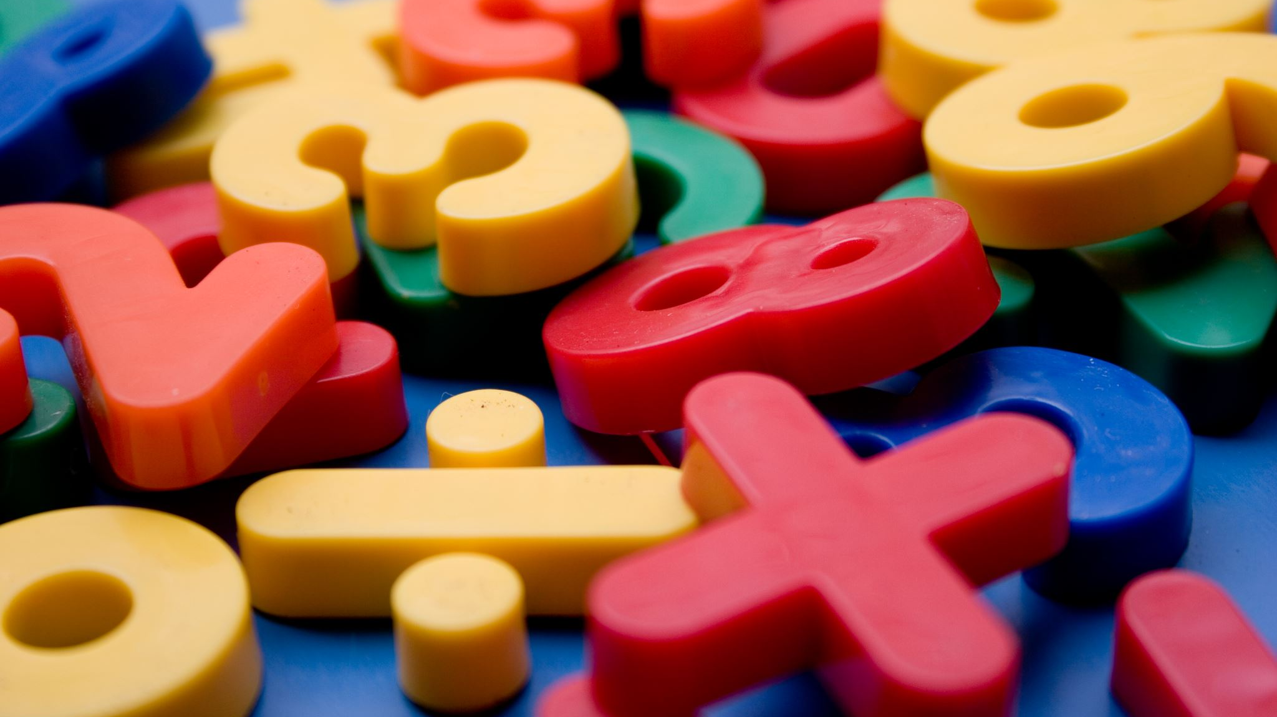
Learning
Question: Where do all the magic numbers come from?
Features in convolutional layers
Voting weights in fully connected layers
Answer: Backpropagation Algorithm

Slide 84
Backprop
Error = right answer – actual answer
.92
X
Convolution
ReLU
Fully
connected
Fully
connected
Convolution
ReLU
Convolution
ReLU
Pooling
Pooling
O
.51

Slide 85
Backprop
.92
X
Convolution
ReLU
Fully
connected
Fully
connected
Convolution
ReLU
Convolution
ReLU
Pooling
Pooling
O
.51

Slide 86
Backprop
.92
X
Convolution
ReLU
Fully
connected
Fully
connected
Convolution
ReLU
Convolution
ReLU
Pooling
Pooling
O
.51

Slide 87
Backprop
.92
X
Convolution
ReLU
Fully
connected
Fully
connected
Convolution
ReLU
Convolution
ReLU
Pooling
Pooling
O
.51

Slide 88
Backprop
.92
X
Convolution
ReLU
Fully
connected
Fully
connected
Convolution
ReLU
Convolution
ReLU
Pooling
Pooling
O
.51

Slide 89
Backprop
.92
X
Convolution
ReLU
Fully
connected
Fully
connected
Convolution
ReLU
Convolution
ReLU
Pooling
Pooling
O
.51

Slide 90
Gradient descent
For each feature pixel and voting weight, adjust it up and down a bit and see how the error changes.
error
weight

Slide 91
Gradient descent
For each feature pixel and voting weight, adjust it up and down a bit and see how the error changes.
error
weight

Slide 92
Hyperparameters
Convolution
Number of features
Size of features
Pooling
Window size
Window stride
Fully Connected
Number of neurons

Slide 93
Architecture
How many of each type of layer?
In what order?

Slide 94
Not Just Images
Any 2D (or 3D) data.
Things closer together are more closely related than things far away.

Slide 95
Images
Columns of pixels
Rows of pixels

Slide 96
Sound
Time steps
Intensity in each
frequency band

Slide 97
Text
Position in
sentence
Words in
dictionary

Slide 98
Limitations
ConvNets only capture local “spatial” patterns in data.
If the data can’t be made to look like an image, ConvNets are less useful.

Slide 99

Rule of Thumb
If your data is just as useful after swapping any of your columns with each other, then you can’t use Convolutional Neural Networks.
ConvNets are great at finding patterns and using them to classify images.

